Slide 1


Slide 2
Linux-Ubuntu
How to connect to the uwosecure-v2 network with Linux-Ubuntu

Slide 3
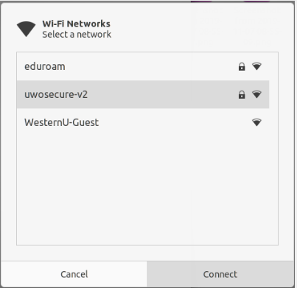
Open the system menu from upper right corner of the screen.
Select 'Wi-Fi Not Connected'. The Wi-Fi section of the menu will expand.
Click 'Select Network'.
Click 'uwosecure-v2'

Slide 4
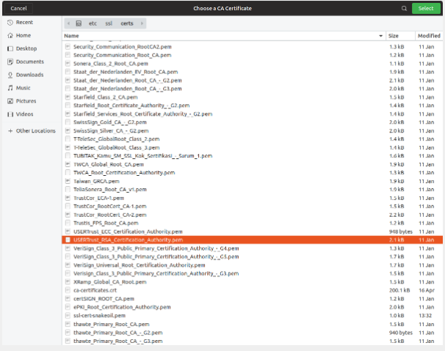
5. In the 'Wi-Fi Network Authentication Required' window, enter/select the following: Security: choose 'WPA & WPA2 Enterprise' Authentication: choose 'Protected EAP (PEAP)' CA Certificate: choose 'Select from file...' Within the 'Choose a CA certificate...' window: Navigate to File System: /etc/ssl/certs Look for 'USERTrust_RSA_Certification_Authority.pem' (if there are two, click on the first one only). Click 'Open'.

Slide 5
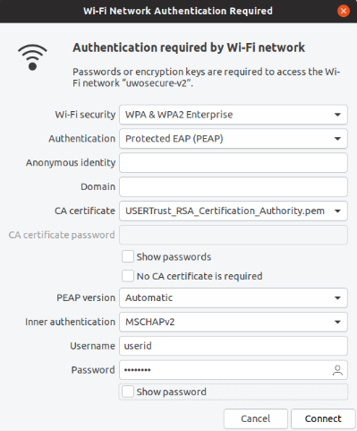
PEAP version: leave as 'Automatic' Inner authentication: choose 'MSCHAPv2' Username: your Western user ID Password: your Western password
6.) Click 'Connect'.

